Slide 1


JSPM’s Jayawantrao Sawant College of Engineering, Hadapsar Pune
Department of Mechanical Engineering
BE Project Registration Seminar 2022-23
Project Title:
Vehicle Accident Prevention Alert Using Maching Learning
Group No.: 2212
Group Members with Roll Number
Nikhil Kapare (4136)
Krushna Pawar (4160)
Suhas Barangule (4105)
Prathamesh Jadhav (4130)
Project Guide
Prof. Vijaya Avati

Slide 2
Contents
JSPM’s Jayawantrao Sawant College of Engineering, Hadapsar Pune
Department of Mechanical Engineering
BE Project Registration Seminar 2022-23
1. Abstract
2. Introduction
3. Literature Survey
4. Significance / Importance of Topic
5. Objectives
6. Methodology
7. References

Slide 3
Abstract :-
JSPM’s Jayawantrao Sawant College of Engineering, Hadapsar Pune
Department of Mechanical Engineering
BE Project Registration Seminar 2022-23
The project deals with prevention of vehicle accidents.
This project mainly related to road accidents that happen in sleepy and half sleep persons while in driving mode.
The machine learning model detects the half sleep persons by its facial expression and alert the alarm by using buzzer.
Machine learning model detects face using camera.
And model is created by using python language.

Slide 4
Introduction :-
JSPM’s Jayawantrao Sawant College of Engineering, Hadapsar Pune
Department of Mechanical Engineering
BE Project Registration Seminar 2022-23
Road accident have become a major issue due to the following reasons:-
Increase in number of vehicles;
Growing number of rackless drivers and
Lack of proper driving skill.
The long hours of continuous driving is major issue of road accidents.
In this project, we are designing a system, which will contiuously monitor the facial expressions of the driver using camera.
In this presentation we are explaining how and what we are going to do throughtout the project.

Slide 5
Literature Survey :-
JSPM’s Jayawantrao Sawant College of Engineering, Hadapsar Pune
Department of Mechanical Engineering
BE Project Registration Seminar 2022-23
Sr. No. | 1 | 2
Paper Title | Smart Vehicle Accident Prevention System | Vehicle Accident Detection System
Authors | Akansha Sarawat, Ankush Mehrotra | Dr. Deepa Deshpande, Sarjil Tikki
Year | March- 2018 | July- 2020
Methods | The result obtain is based on following paramerters:- face segmentation, detection of eye blink, yawn detection. | The four input factor are:- Object detection, driver drowsiness, conditions and mutual object detection.
validations | The system proposed in this paper is acceptable level of performance and an average accuracy of 93.18%. Real-time data processing and high accuracy distinguish this system for the similar systems. | In this paper the output is based on multiple factors such as speed, weather conditions, nearby vehicles density and driver fatigue. The output factors are alarm, automated brake and de-acceleration.

Slide 6
Significance / Importance of Topic:-
JSPM’s Jayawantrao Sawant College of Engineering, Hadapsar Pune
Department of Mechanical Engineering
BE Project Registration Seminar 2022-23
The 450000 average accidents happen every year in India.
And mainly 40% of accidents happens due to sleepy and half sleepy persons.
To reduce it the system which alert the driver before the accident like condition is necessary.

Slide 7
Objectives:-
JSPM’s Jayawantrao Sawant College of Engineering, Hadapsar Pune
Department of Mechanical Engineering
BE Project Registration Seminar 2022-23
Objectives of the project are :-
To learn how to solve the real world problems using machine learning model.
To learn how to develop, how to test and how to analysis the machine learning model.
To make a core engineering student understand and analyse how AI is important in real world problems.
To explore career alternatives.

Slide 8
Methodology:-
JSPM’s Jayawantrao Sawant College of Engineering, Hadapsar Pune
Department of Mechanical Engineering
BE Project Registration Seminar 2022-23
In this project we try to build an machine learning model which recognize the facial expressions of vehicle driver ,by using the facial expressions the model identifies the emotions of the driver .
Then by using data feeded into this the model defines case,
Alarm :-
If driver drowsiness condition satisfies while the vehicle is moving then system is going to produce alarm which will help driver to recover from drowsy situation.

Slide 9
Block diagram:-
JSPM’s Jayawantrao Sawant College of Engineering, Hadapsar Pune
Department of Mechanical Engineering
BE Project Registration Seminar 2022-23
Camera
Eye detection
Fatigue level detection
Face detection
Fatigue detection
Control unit
Text to speech
Alarm notification

Slide 10
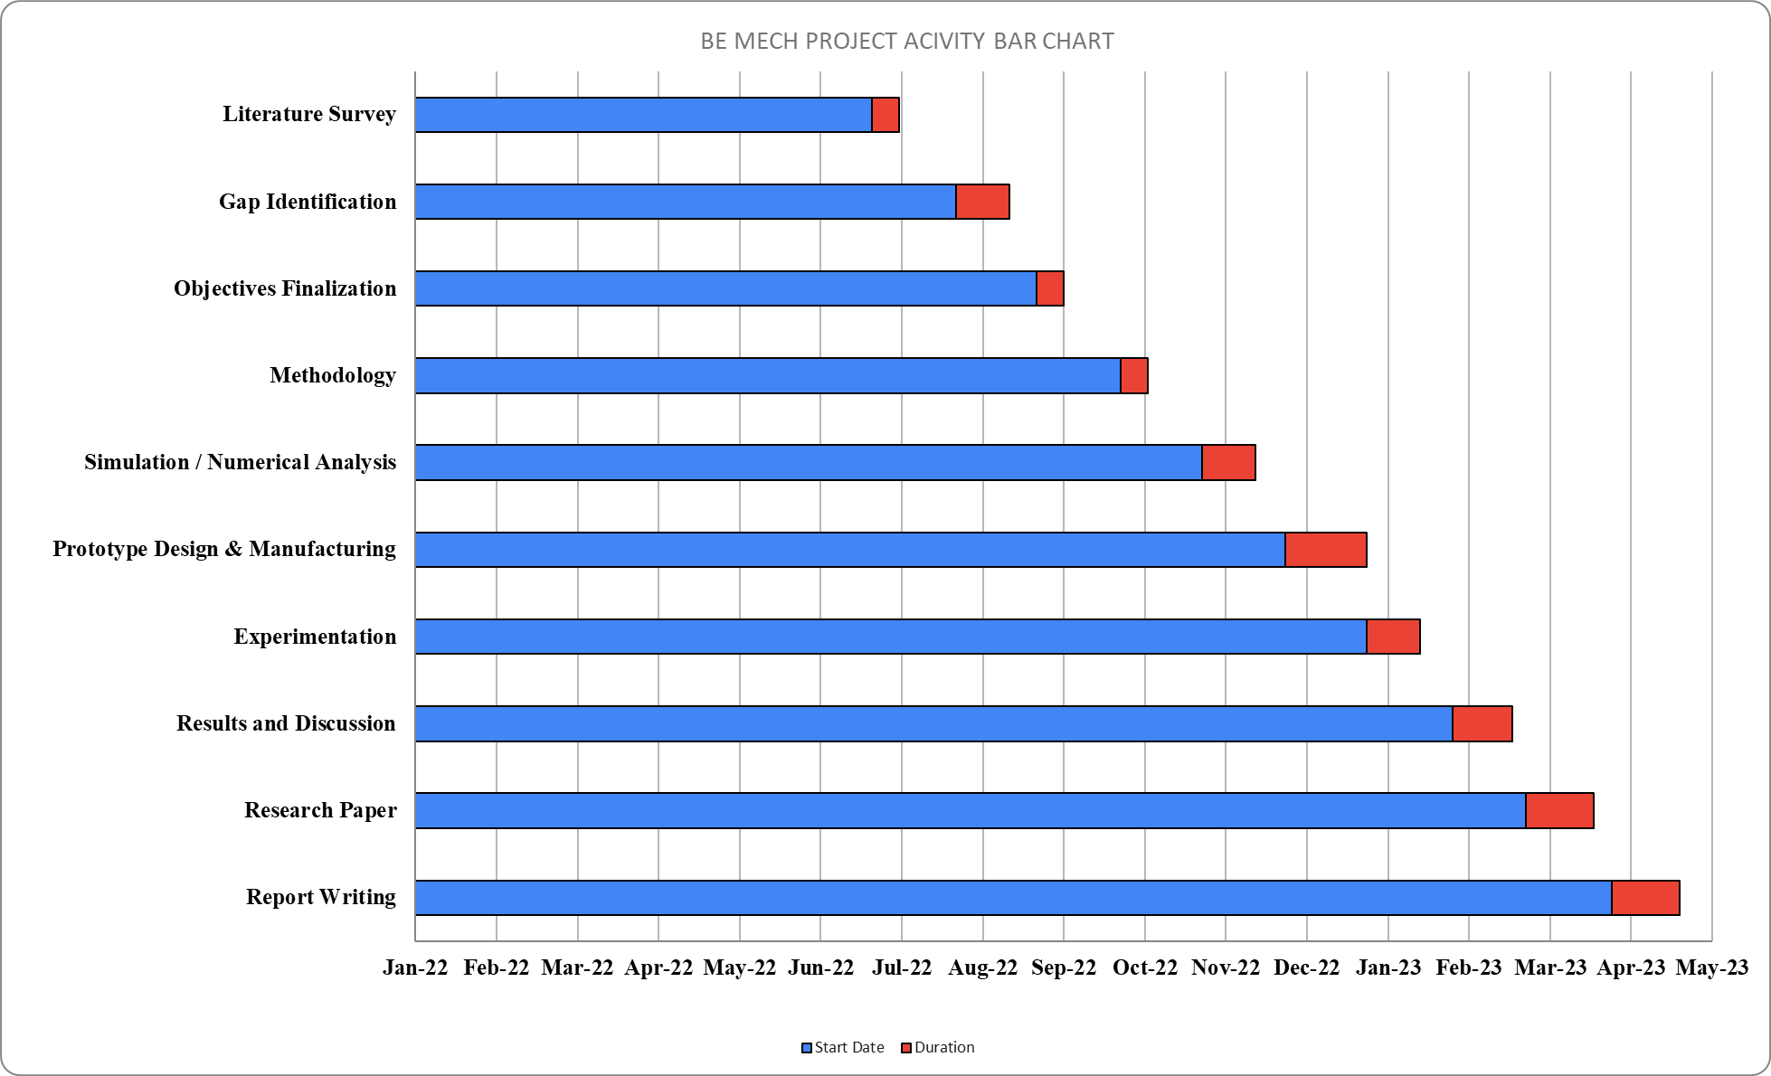
Completion chart:-
JSPM’s Jayawantrao Sawant College of Engineering, Hadapsar Pune
Department of Mechanical Engineering
BE Project Registration Seminar 2022-23

Slide 11
References
JSPM’s Jayawantrao Sawant College of Engineering, Hadapsar Pune
Department of Mechanical Engineering
BE Project Registration Seminar 2022-23
Case studies:-
Smart Vehicle Accident Prevention System
Vehicle Accident Detection System
Links:-
https://www.google.com/amp/s/m.economictimes.com/news/india/around-3-75-lakh-accidental-deaths-in-india-in-2020-over-35-pc-in-road-crashes-ncrb-data/amp_articleshow/87370360.cms
https://en.m.wikipedia.org/wiki/Traffic_collisions_in_India

